Slide 1

Spring RESTful Web Services
Name: Maumita Saha
Emp ID: 46067476
Batch: JEE FS With React

Slide 2
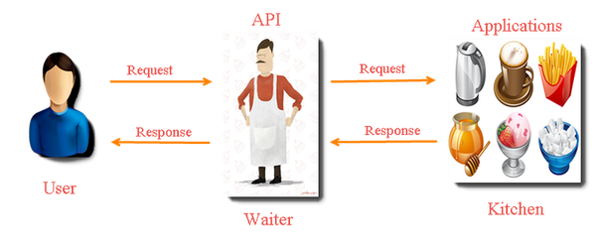
WHAT IS REST?
REpresentational State Transfer (REST)
Creating Web services
First introduced by Roy Fielding in 2000.
Architecture
-Lightweight
-maintainable
-Scalable service
The underlying protocol for REST is HTTP.

Slide 3
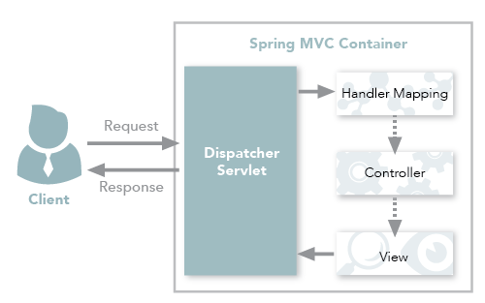
SPRING REST WORKFLOW

Slide 4

RESTful URLS
HTTP METHOD
SERVICE NAME
PATH
RESOURCES

Slide 5
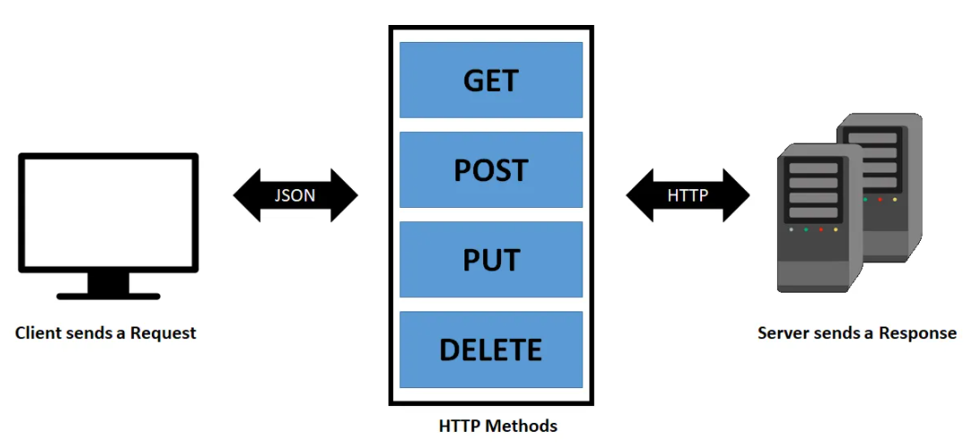
HTTP METHODS IN REST
HTTP Method | Operation | Comment
GET | Read resources from server | Uses only for the read operation. GET should be idempotent
POST | Create new resource | Should only be used to create a new resource
PUT | Update / Replace Resource | Update an existing resource. Think of PUT method as putting a resource
DELETE | Delete Resource | To remove a given resource. DELETE operation is idempotent
PATCH | Partial Update / Modify | Partial update to a resource should happen through PATCH

Slide 6

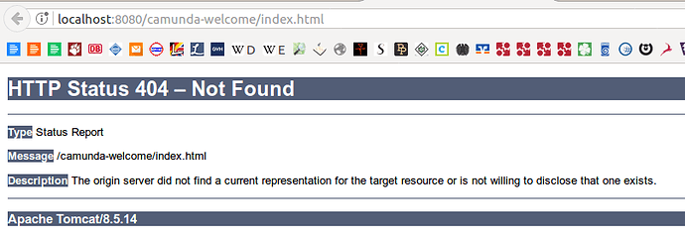
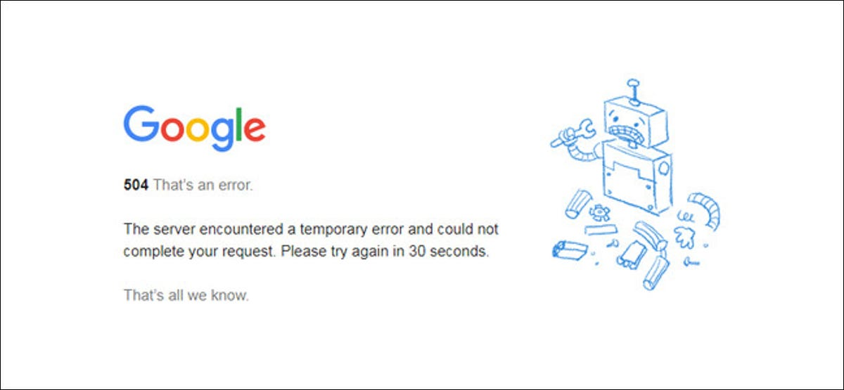

Slide 7

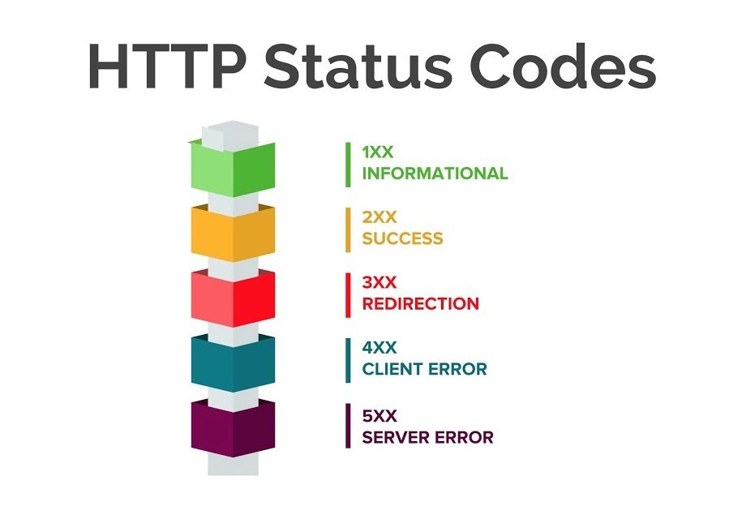
HTTP Status Code
Status Code Category | Description | Example
1XX – Informational | Request was received and is in continuing process | 100 (Continue ) , 101
2XX – Successful | Request was successfully received, understood and accepted | 200 (OK), 201(Created), 202 (Accepted)
3XX – Redirection | Further action is needed to be taken in order to complete the request | 301 (Moved Permanently), 302, 304
4XX – Client Error | The request contains bad syntax or cannot be fulfilled | 400 ( Bad Request), 401, 403, 404, 405
5XX – Server Error | The server failed to fulfill an apparently valid request | 500 (Internal Server Error), 502, 503, 505

Slide 8
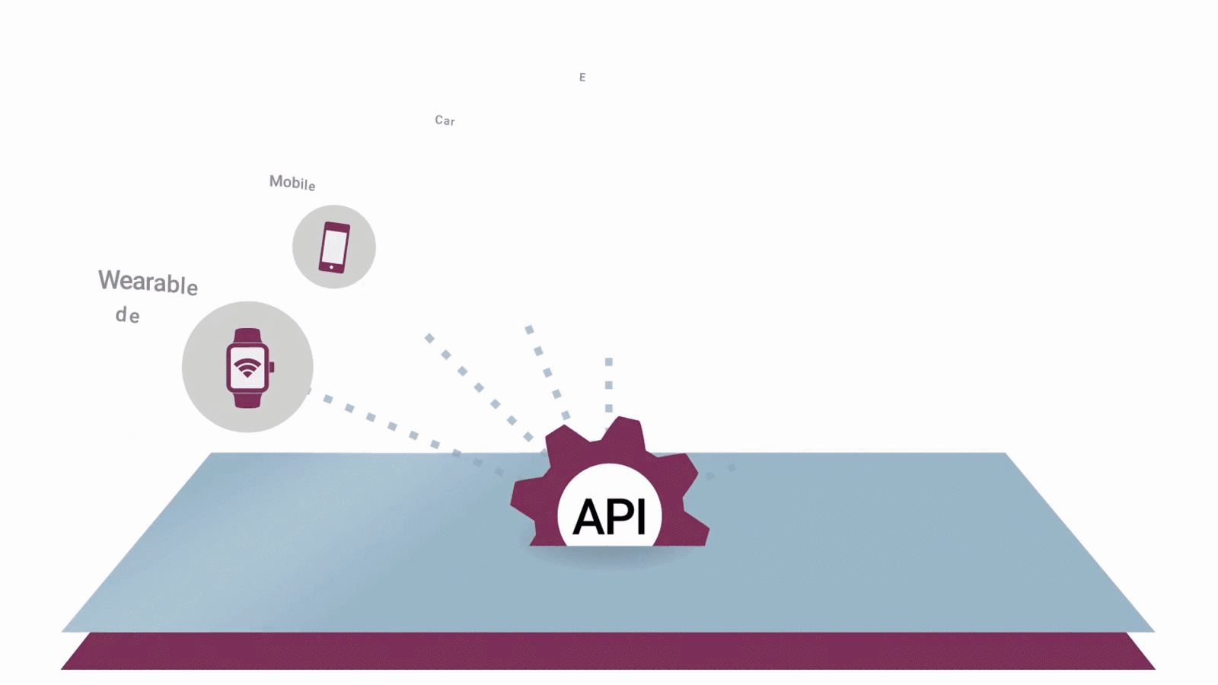
APPLICATIONS

Slide 9
Pros
Cons
1.They are simpler and flexible to implement
2.It supports greater variety of data formats e.g. JSON, XML, YAML, etc.
3.It is faster and provides better performance
1.To implement state related query the REST Headers are required which is a clumsy work
2.The PUT and DELETE operations are not usable through firewalls or in some browsers.

Slide 10


Slide 11


Slide 12


